Slide 1
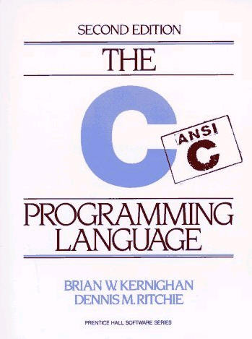

Working with
Compiled Languages
Derrick Kearney
HUBzero® Platform for Scientific Collaboration
Purdue University
Original slides by Michael McLennan
This work licensed under
Creative Commons
See license online:
by-nc-sa/3.0

Slide 2


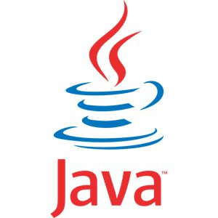
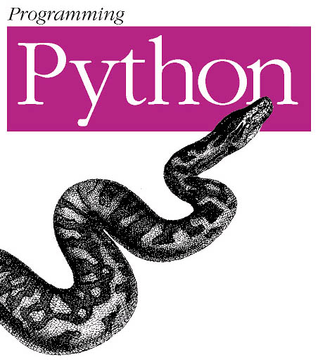


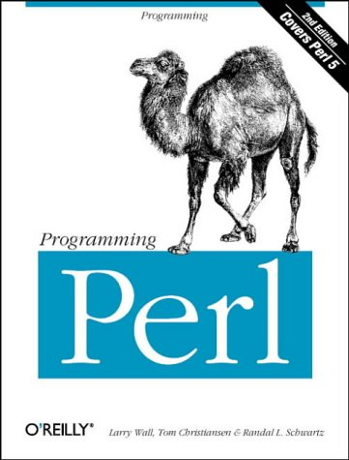
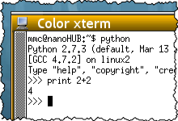

Two Different Paradigms
Interpreted
Compiled
your code
compiler
executable
this is “the program” you run
Code runs slower
Easier to build and debug
Code runs faster
Harder to build and debug
Notes:
Two types of languages:
1. Interpreted – write script and another program reads each line one at a time.
2. Compiled – hand program off to compiler, it reads code, checks for errors, converts to machine code, stores in executable.

Slide 3
Examples of Compiled Languages
file: plinko.c
file: plinko.f
#include <stdio.h>
#include <stdlib.h>
#include <math.h>
#define LEVELS 9
int
main(int argc, char **argv)
{
int max, drop, i, pos, count[LEVELS+1];
double rnum;
printf(“Number of drops?\n");
if (scanf("%d", &max) != 1) {
fprintf(stderr,"bad number!\n");
exit(1);
}
for (i=0; i < LEVELS+1; i++) {
count[i] = 0;
}
program plinko
implicit none
integer levels
parameter ( levels=9 )
integer max, drop, i, pos,
+ count(levels+1)
double precision rnum;
write(6,*) 'Number of drops?'
read(5,*) max
c set all counts to zero
do 10 i=1,levels+1
count(i) = 0;
10 continue
Notes:
Some people say C and Fortran are dead languages.
Due to their speed in performing arithmetic and long history with numerical recipes, these languages are sticking around

Slide 4
Compiling and Running C Code
$ gcc -g plinko.c -o plinko -lm
Add debugging info for later
Create executable called “plinko”
Include math library for drand48()
$ ./plinko
Number of drops?
500
Statistics:
Bucket 0: 1
Bucket 1: 14
Bucket 2: 24
Bucket 3: 87
Bucket 4: 137
Bucket 5: 102
Bucket 6: 95
Bucket 7: 29
Bucket 8: 10
Bucket 9: 1
Notes:
Use gcc to compile c code
Explain flags
How to launch program after compile

Slide 5
Compiling and Running Fortran Code
$ gfortran -g plinko.f -o plinko
Add debugging info for later
Create executable called “plinko”
$ ./plinko
Number of drops?
500
Statistics:
Bucket 1: 1
Bucket 2: 9
Bucket 3: 28
Bucket 4: 77
Bucket 5: 141
Bucket 6: 124
Bucket 7: 75
Bucket 8: 35
Bucket 9: 8
Bucket 10: 2

Slide 6
Makefiles
$ gcc -g plinko.c -o plinko -lm
$ vi plinko.c
$ gcc -g plinko.c -o plinko -lm
$ vi plinko.c
…
$ make
$ vi plinko.c
$ make
$ vi plinko.c
$ make
$ make
$ make clean
Follows the instructions in a “make” file
file: Makefile
plinko: plinko.c
gcc -g plinko.c -o plinko -lm
clean:
rm -f *.o plinko
TAB
No changes,
does nothing
TAB
Create with your favorite text editor
Must have tabs on production lines
Must be named: Makefile
Clean up and start from scratch
Notes:
We find ourselves compiling and debugging a lot
Hard to remember compiler flags
Use a Makefile
Makefiles have targets, dependencies, instructions,
Instructions are tabbed in
Makefile must start with capitol M
Indentations need to be tabs, not spaces

Slide 7
Debugging
What if something goes horribly wrong?
$ ./plinko
Number of drops?
500
Segmentation Fault (Core Dumped)
$ gdb plinko
(gdb) l
4
5 #define LEVELS 9
6
7 int
8 main(int argc, char **argv)
9 {
10 int max, drop, i, pos, count[LEVELS+1];
11 double rnum;
12
13 printf("number of drops?\n");
(gdb) break 13
Breakpoint 1 at 0x80484c5: file plinko.c, line 13.
(gdb) run
Starting program: /home/nanohub/user/bootcamp/plinko/c/plinko
…
Start GNU debugger
with your program
(must be compiled -g)
Stop at this line

Slide 8
Debugging
(gdb) break 13
Breakpoint 1 at 0x80484c5: file plinko.c, line 13.
(gdb) run
Starting program: /home/nanohub/user/bootcamp/plinko/c/plinko
Breakpoint 1, main () at plinko.c:13
13 printf("number of drops?\n");
(gdb) n
number of drops?
14 if (scanf("%d", &max) != 1) {
(gdb) n
500
19 for (i=0; i < LEVELS+1; i++) {
(gdb) n
20 count[i] = 0;
(gdb) n
19 for (i=0; i < LEVELS+1; i++) {
(gdb) p i
$1 = 1

Slide 9
Debugging
(gdb) break 24 if drop == 3
Breakpoint 2 at 0x8048540: file plinko.c, line 24.
(gdb) c
Continuing.
Breakpoint 2, main () at plinko.c:24
24 pos = LEVELS;
(gdb) p drop
$2 = 3
GDB Commands
l line … list source code (starting at optional line)
break line … stop at this line
run arg arg … run program with these arguments
n … next
s … step (step inside routines)
c … continue running to next breakpoint
p expr … print out value of expression

